Slide 1



Team 112
Medical Specialty Classification Using Transformer Models

Slide 2



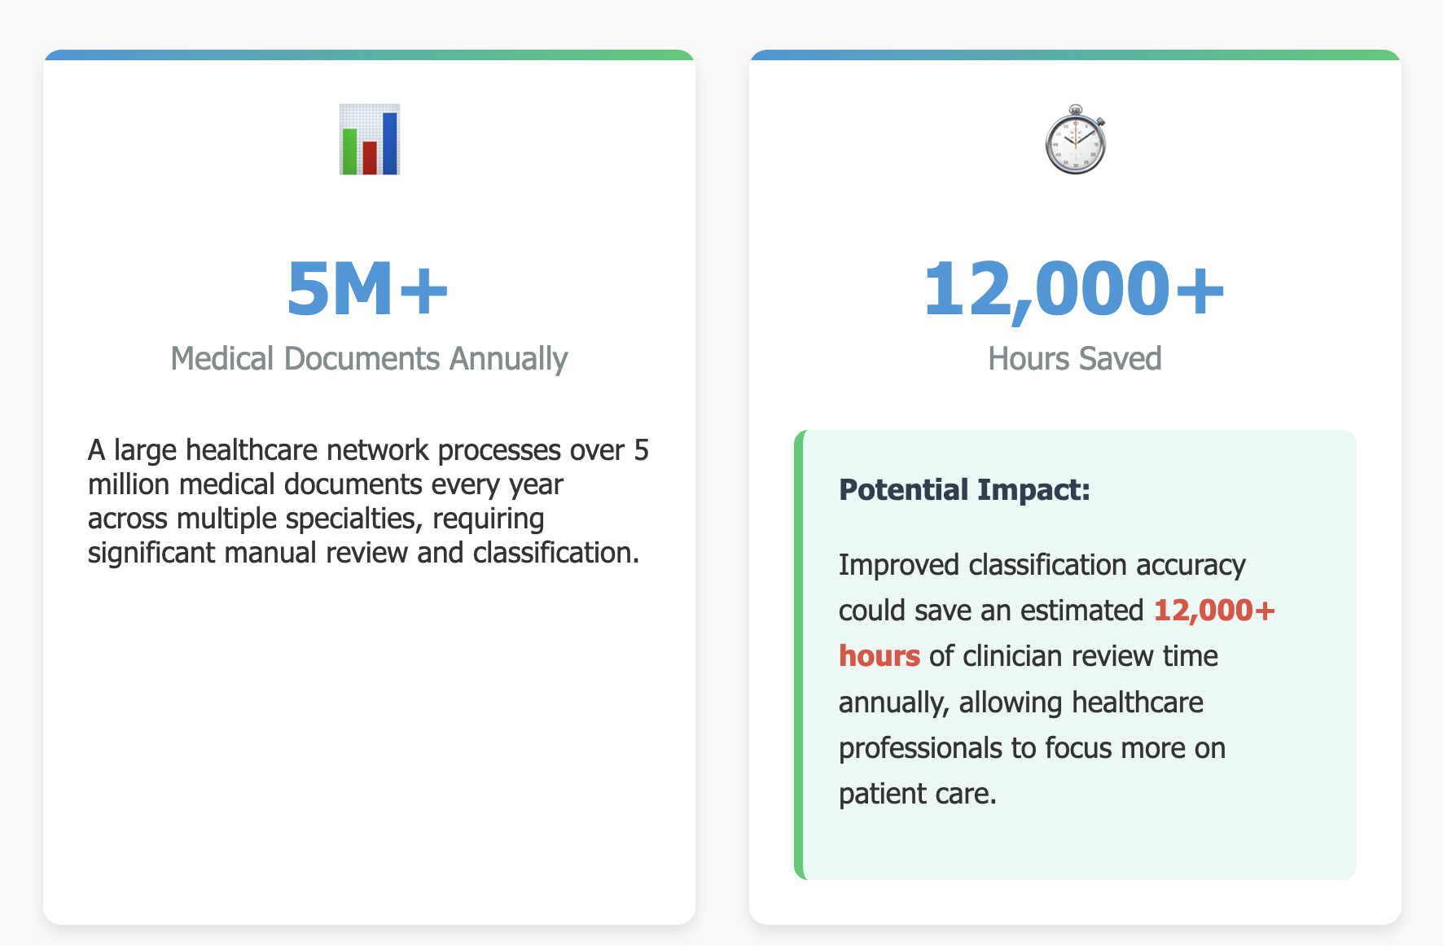

Slide 3
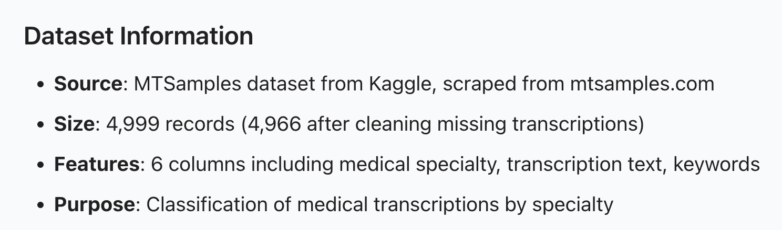
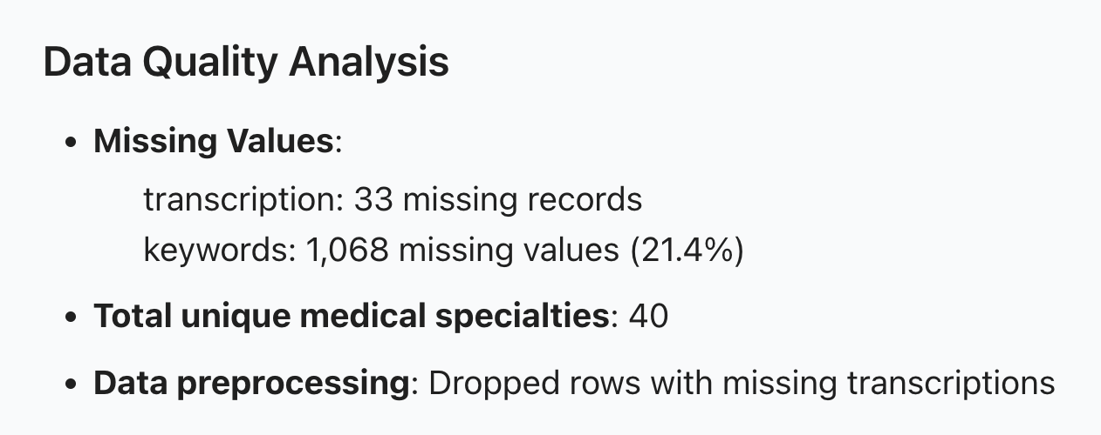
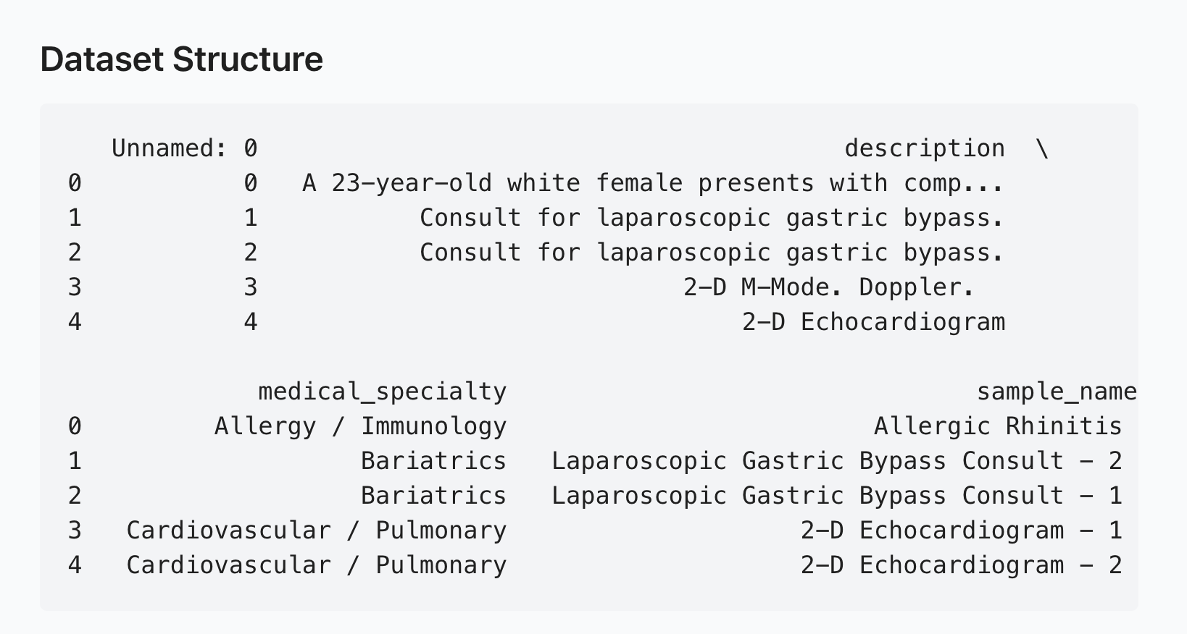

Data
Notes:
https://mermaid.live/edit#pako:eNqNkVtvozAQhf-K5b6mERBCGh5WCpdc2o22SvK0pFq5eCDWGhzZZts0yn9f46Bs-7IC8cD4fGeOZzjjXFDAIS64eMsPRGq0S_Y1Ms8sW--2pDpyUCghmijQL-j-_huKsrZEzxKORBLNRP1ydURWjrMdvGsrS5GDUqwuOyC2QJJFTPyKOatZTniUbnYorV6BUgOqjkwsmWYJq6BWJoJwpk9oA7TJ20T0xvQBPcezjk8tP8-26x-7FMWcKIUiwkmd_0ufW2aRrc3EHO0kMRe4iQsrLt1sQ2oqKjQXEpT-KnrZd1EypVluLlLKdrTb7EvXMquue_qH8ObzbpbeVb9WK1s8ZnNmBkNfIpFt0LkeLfeUrYG2u0LbI-SMcLMJOyIrzGkXcjUofeKAZqhgnId31IdxUQyUluI3hHfT_DWg8BmM-oJxXzDpC6Z9wXlfcNEXNP-qL-n1JVd9wce-4NP_QDzApWQUhwXhCga4AlmRtsbntsce6wNUsMeh-aRQkIbrPd7XF-M7kvqnEBUOtWyMU4qmPNz6NEdKNCSMlJJUt1MJNQUZi6bWOBy5tgcOz_jdVI4znE5GE8cPAs_x3WCATzh0A2_oBUHg-tMH332YON5lgD9sqjMMPHcy9ifOeGpe1x9d_gK1i2qb
This project uses Bio_ClinicalBERT to classify medical documents by specialty. Starting with the MTSamples dataset, we filtered down to 2,324 documents across 12 medical specialties.
After preprocessing the text through cleaning and lemmatization, we generated embeddings using Bio_ClinicalBERT, which is specifically trained on clinical text. This gives us 768-dimensional vectors that capture medical terminology and context far better than general language models.
To improve model performance, we applied dimensionality reduction with PCA, bringing the embeddings down to 100 dimensions while reducing noise and sparsity in the high-dimensional data.
Since our dataset was imbalanced with some specialties having many more documents than others, we implemented SMOTE to create synthetic samples for underrepresented specialties, ensuring our model wouldn't be biased toward common specialties.
Finally, we trained two models: Random Forest, which achieved 74.2% accuracy, and Logistic Regression at 73.2%. The Random Forest model became our final classifier for this task.
Bullet Point Flow for Practice
Start with data overview
MTSamples → 2,324 documents across 12 specialties
Filtered from original 40 specialties for better classification
Walk through the pipeline steps
Text preprocessing → cleaned and lemmatized text
Bio_ClinicalBERT → domain-specific embeddings (768 dimensions)
PCA → reduced dimensions while preserving information
SMOTE → balanced dataset for fair training
Finish with model performance
Random Forest outperformed Logistic Regression
74.2% overall accuracy despite challenging task
Highlight this is our final model

Slide 4
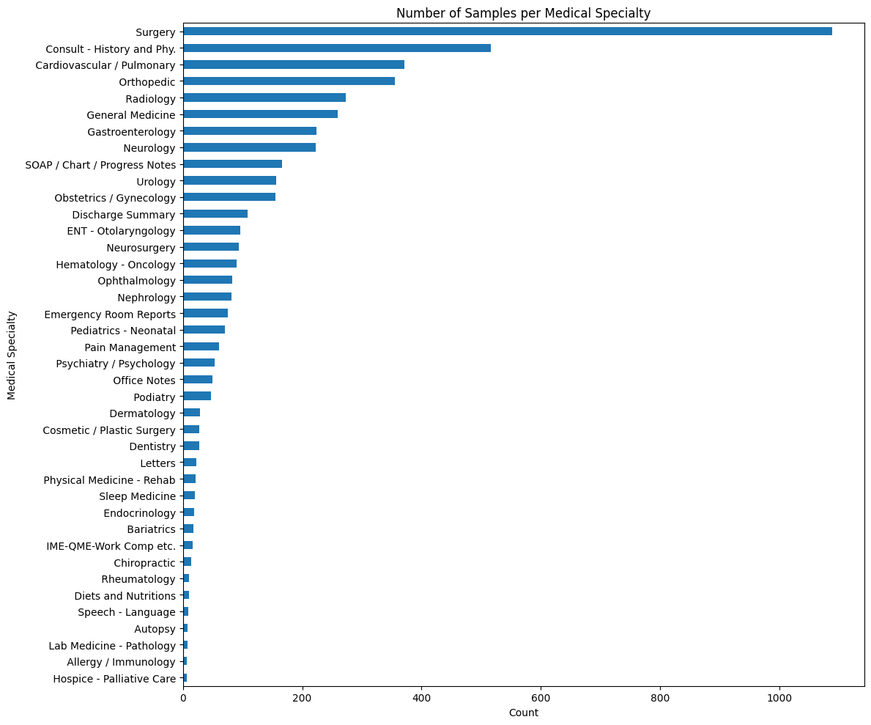
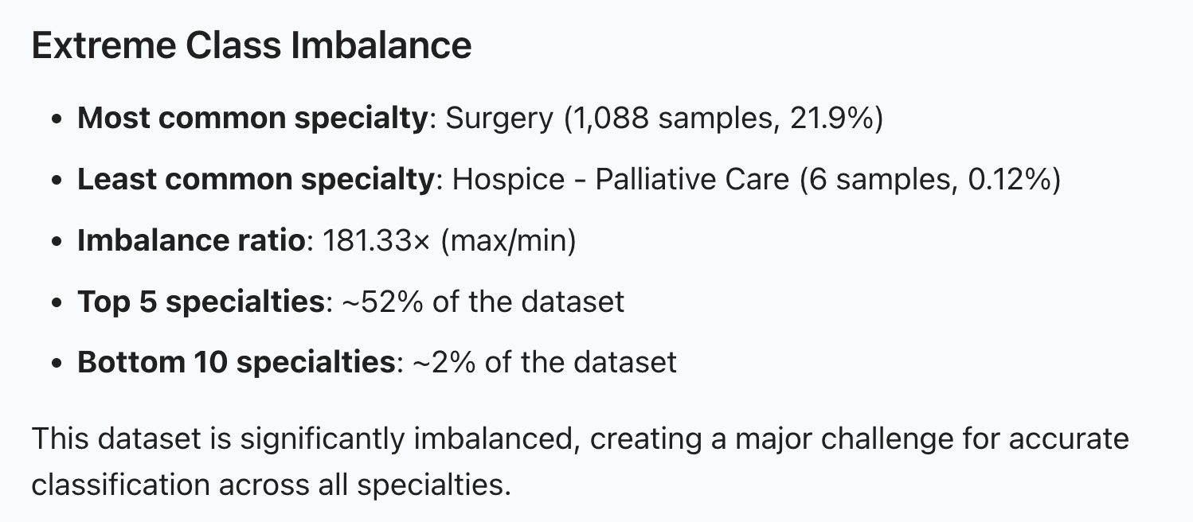

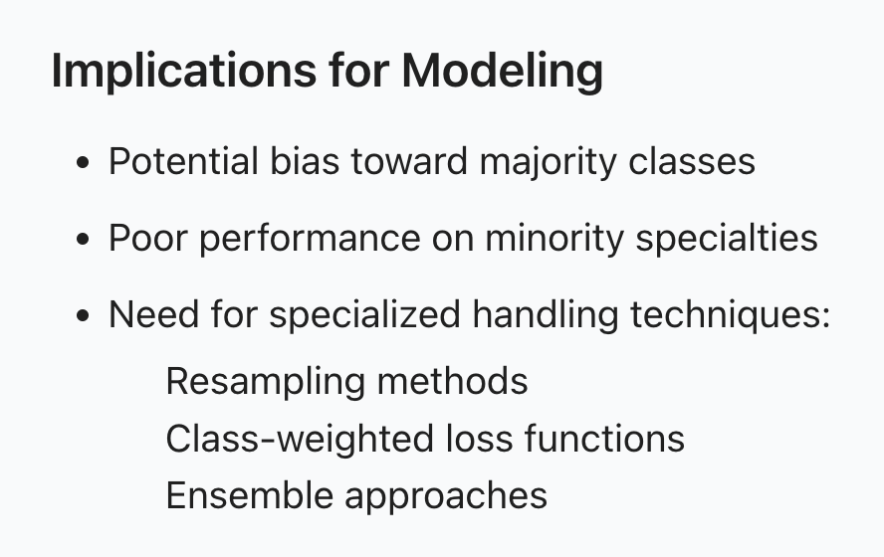
Data Split - 80% Train : 10% Test: 10% Validation

Slide 5
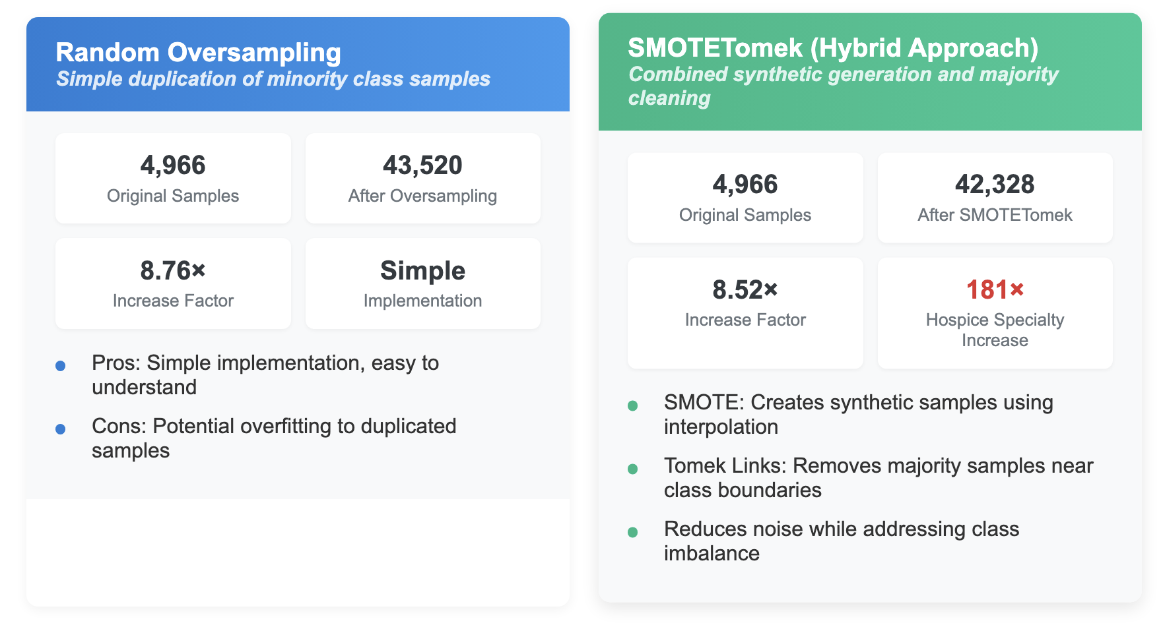
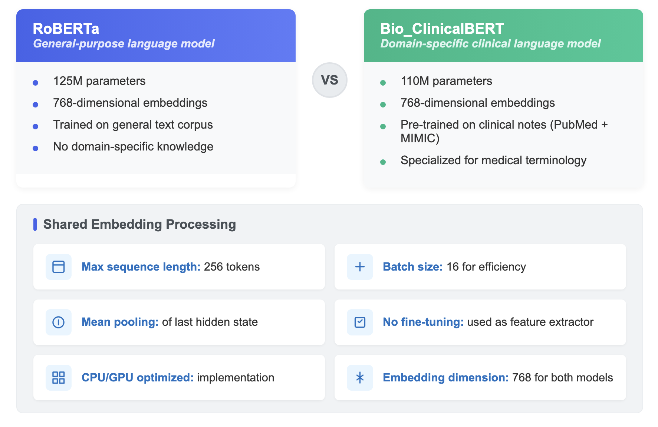
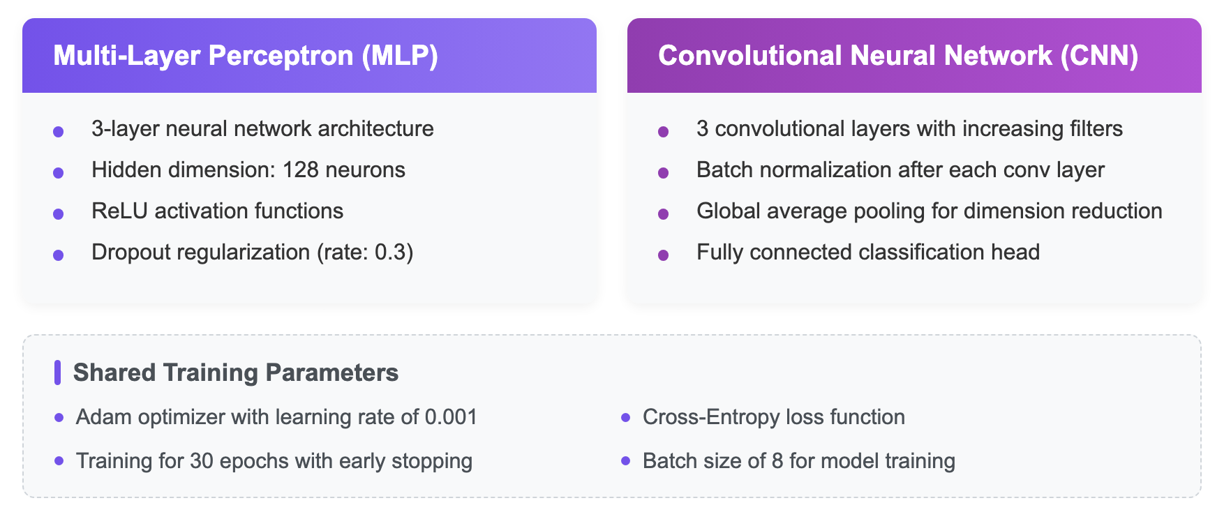
Resampling and Neural Network Approach: MLP and CNN

Slide 6
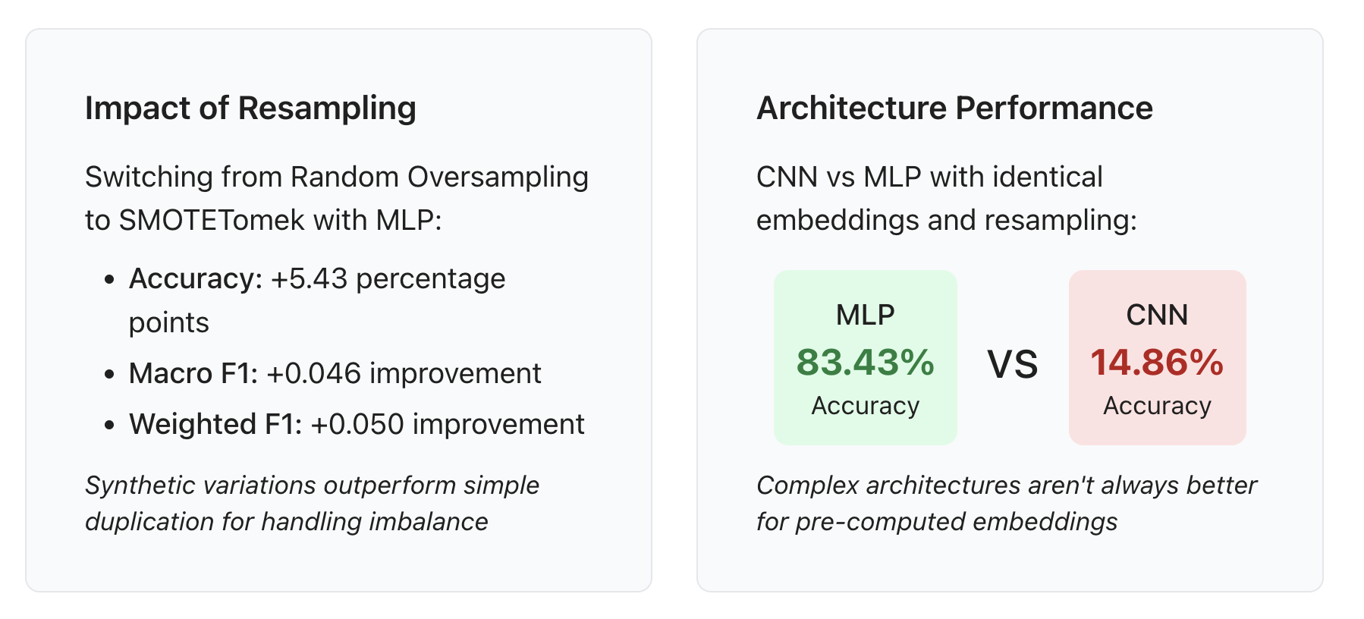
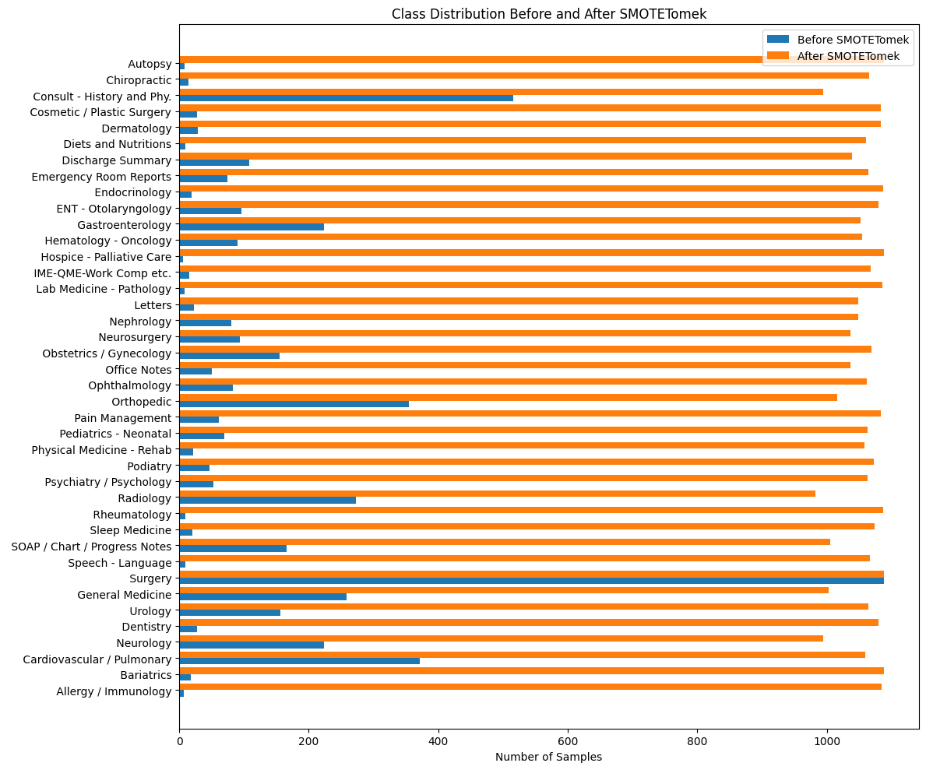
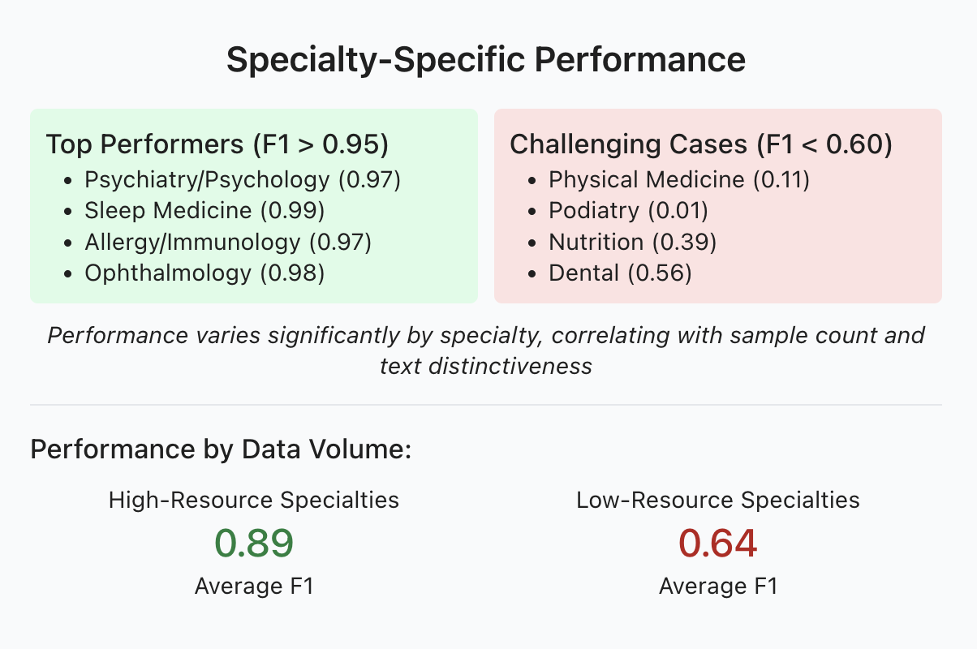
Results & Insights

Slide 7
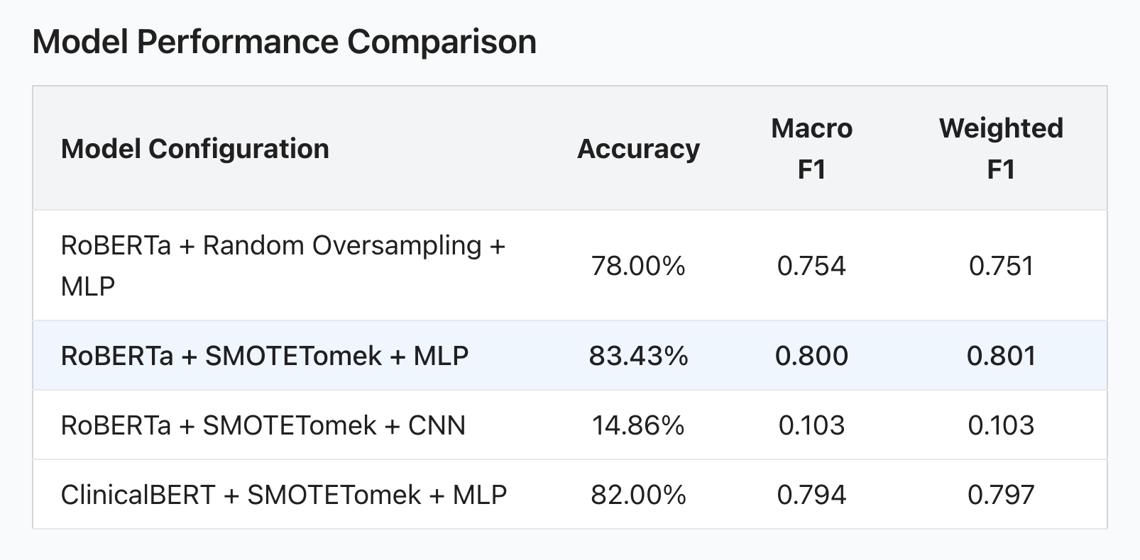
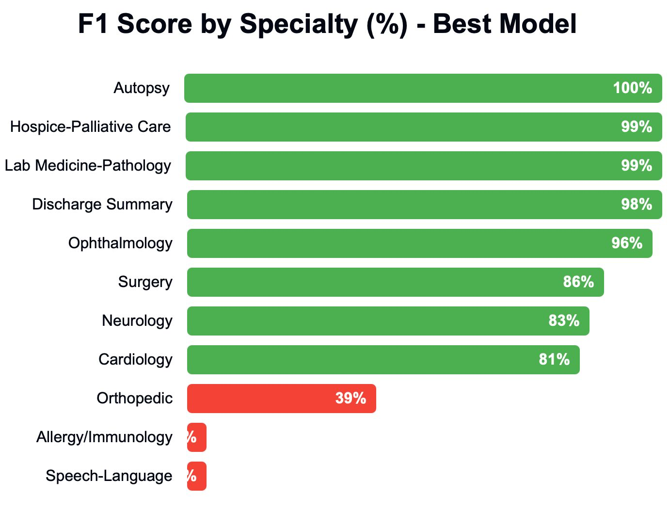

Comparison MLP and CNN

Slide 8
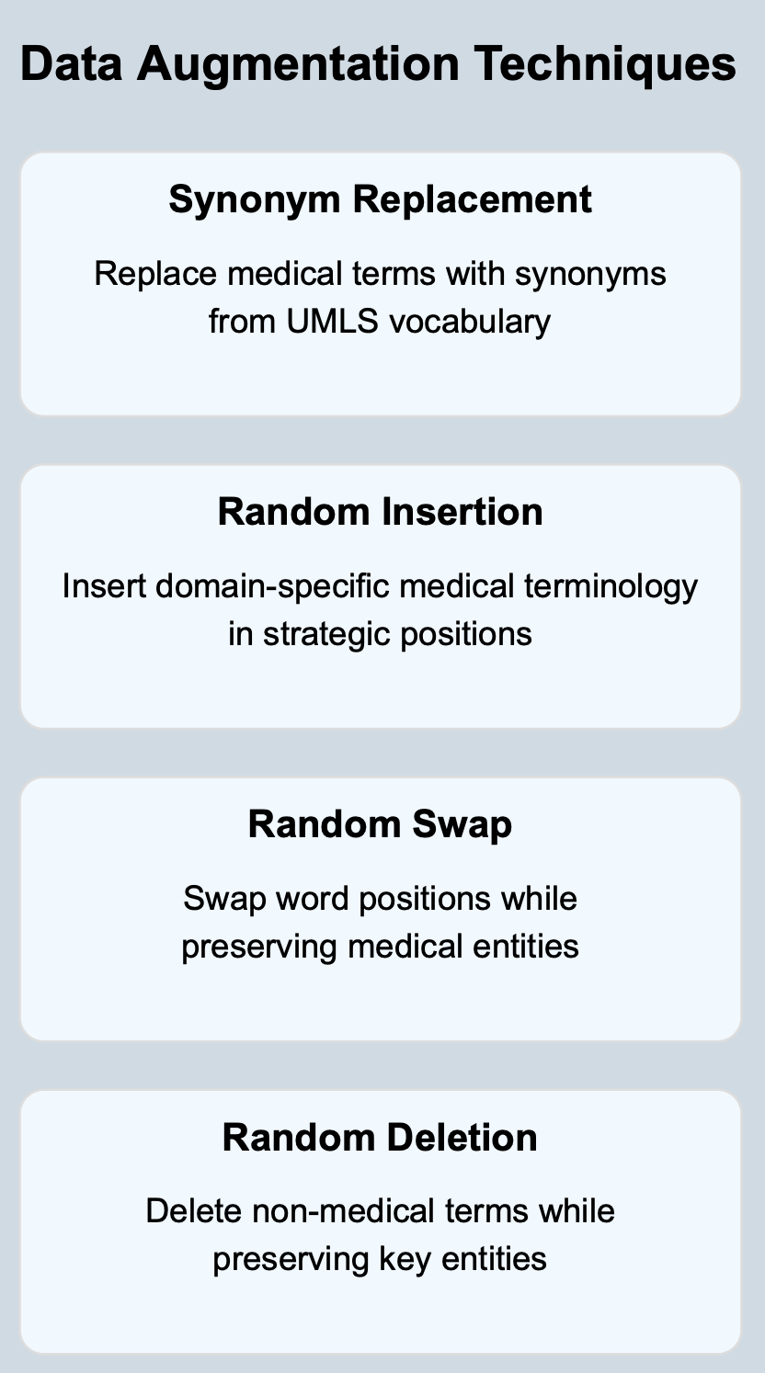
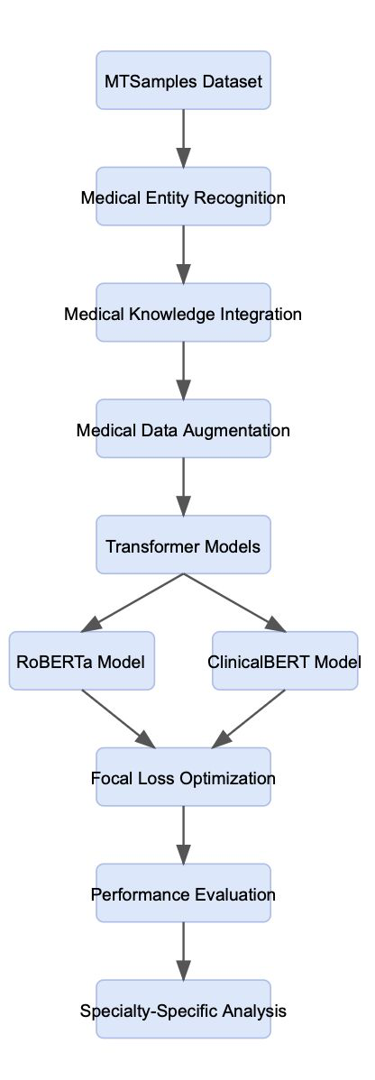
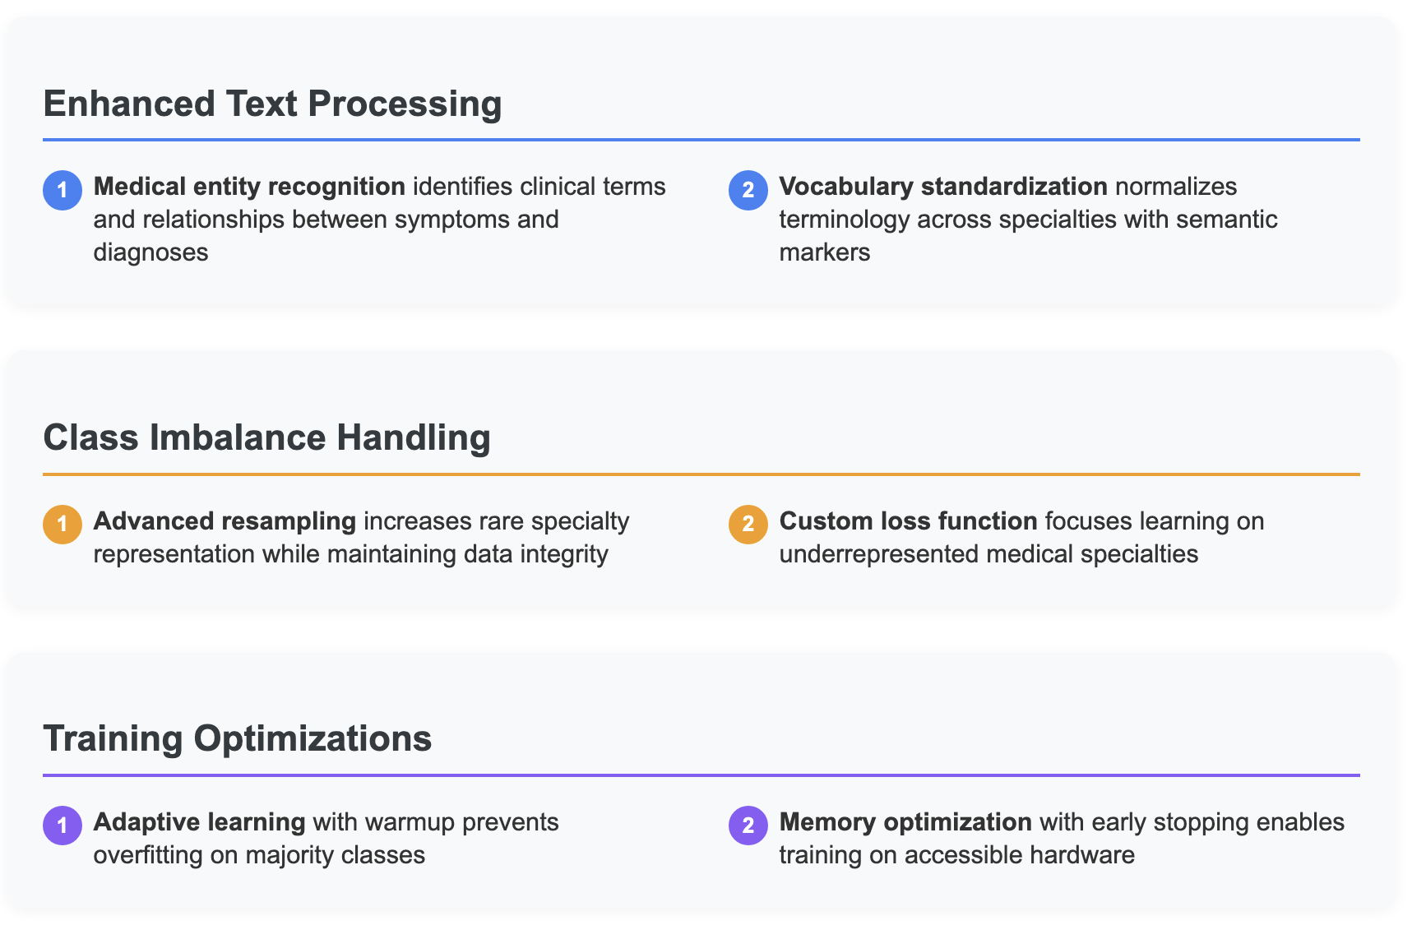
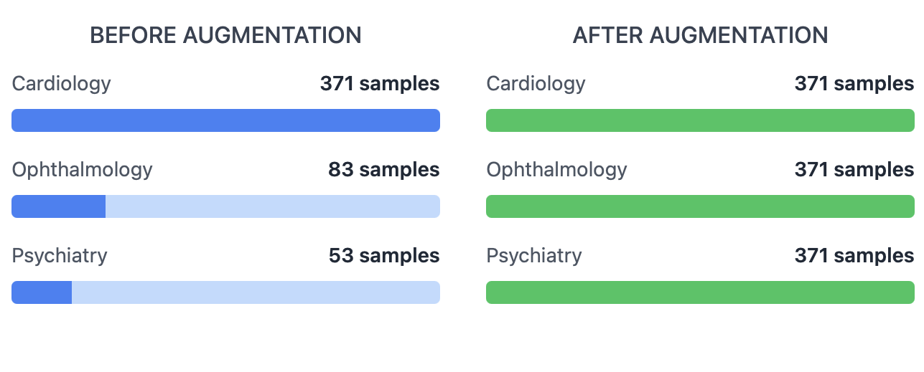
Fine Tuning roBERTa and Bio-ClinicalBERT

Slide 9
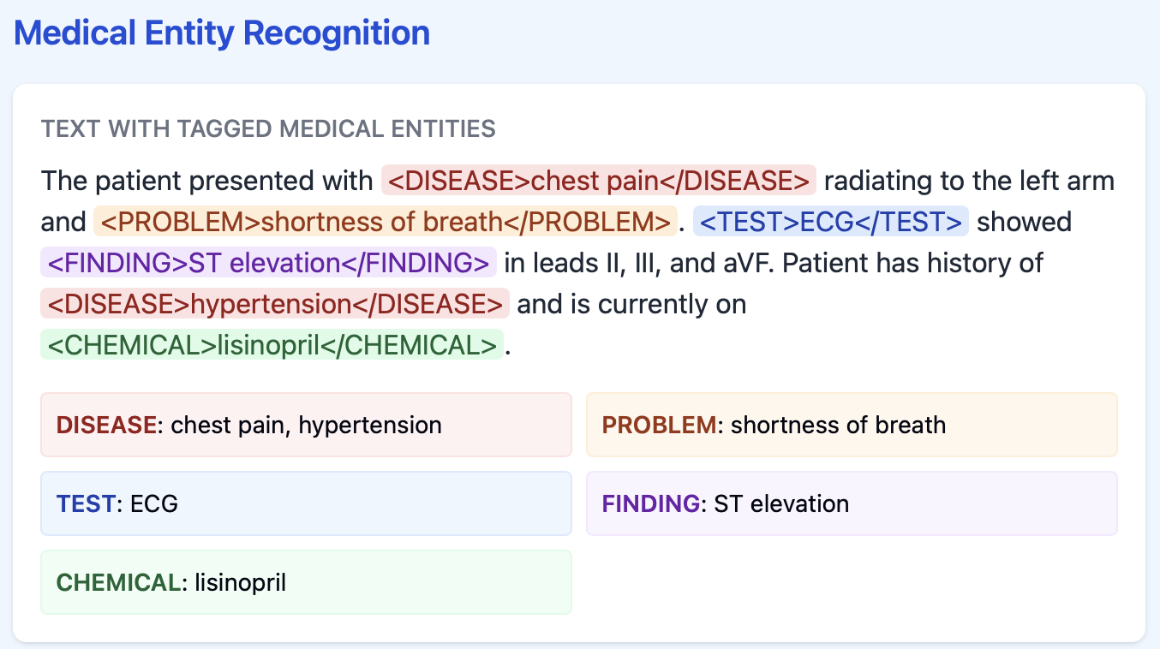
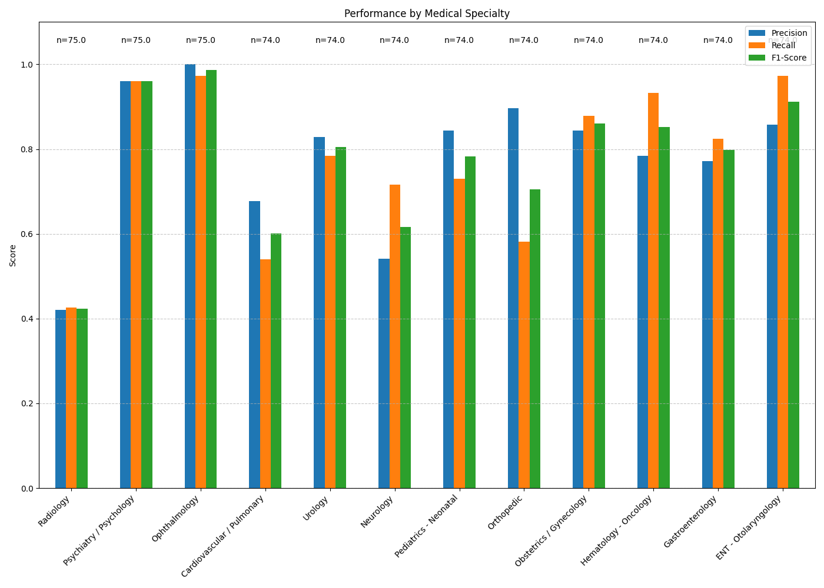
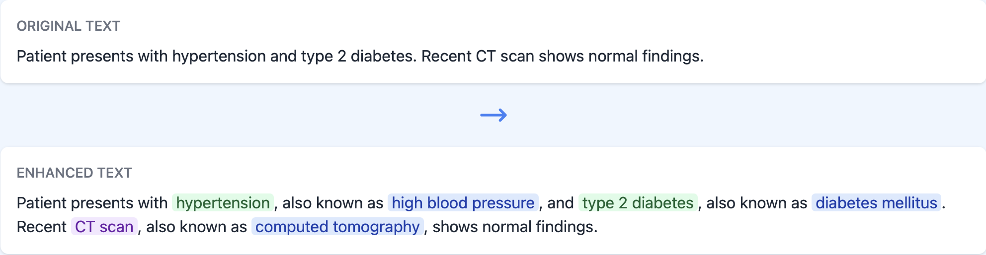
Fine Tuning roBERTa and Bio-ClinicalBERT

Slide 10
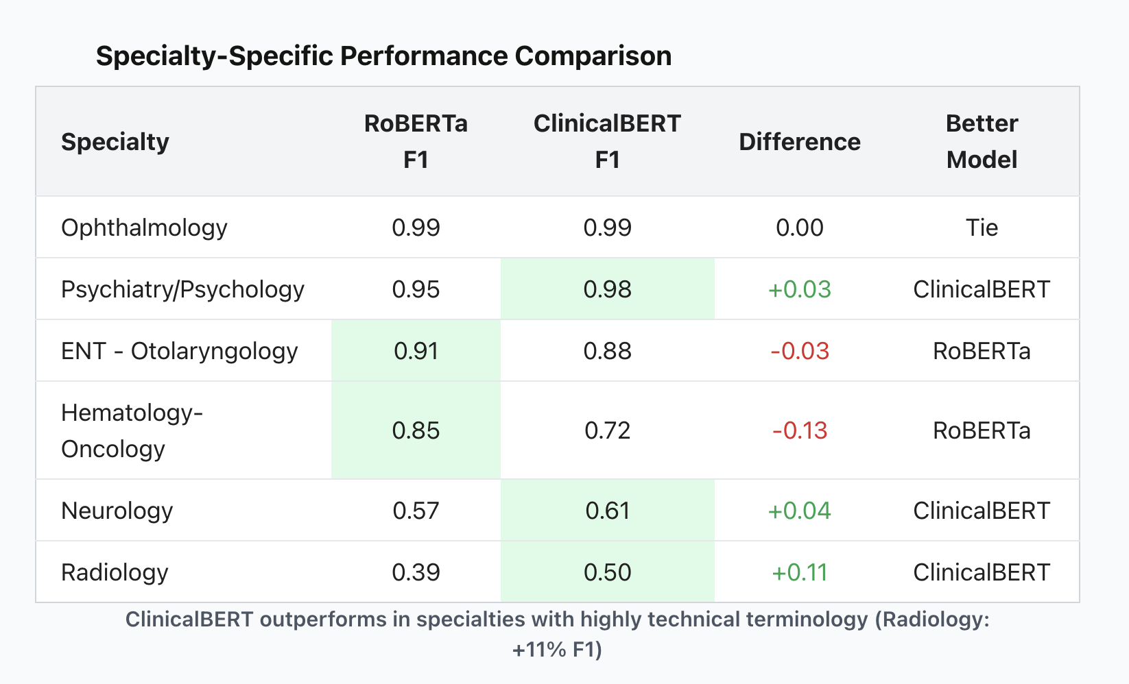
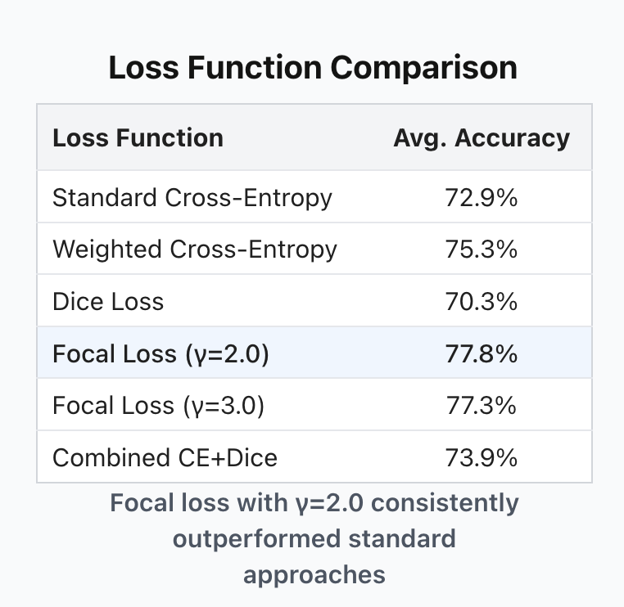
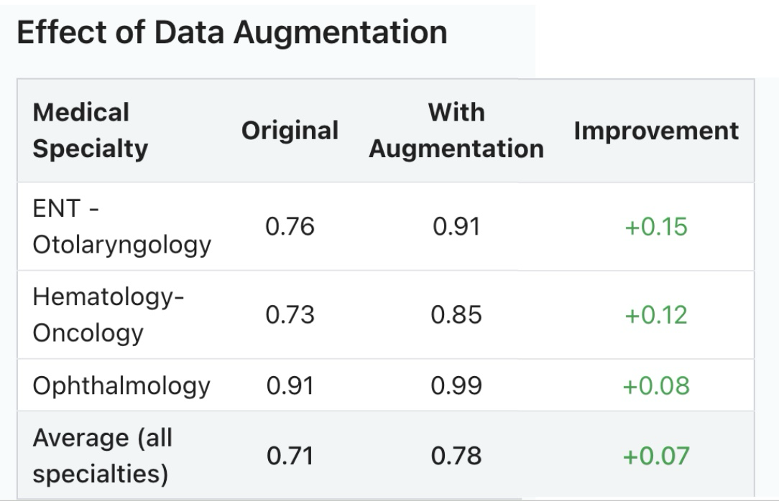
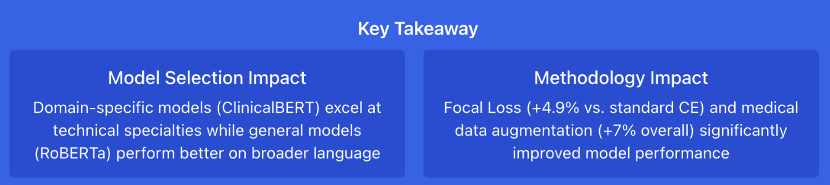
roBERTa & BIO-ClinicalBERT : Results & Insights

Slide 11

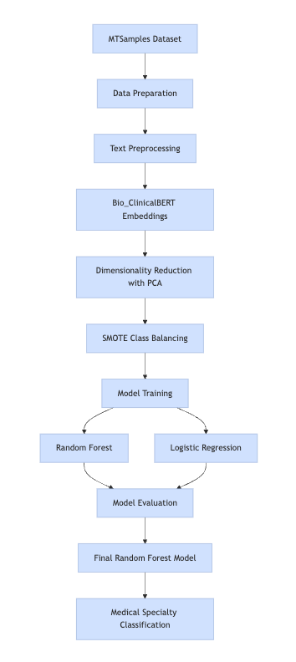
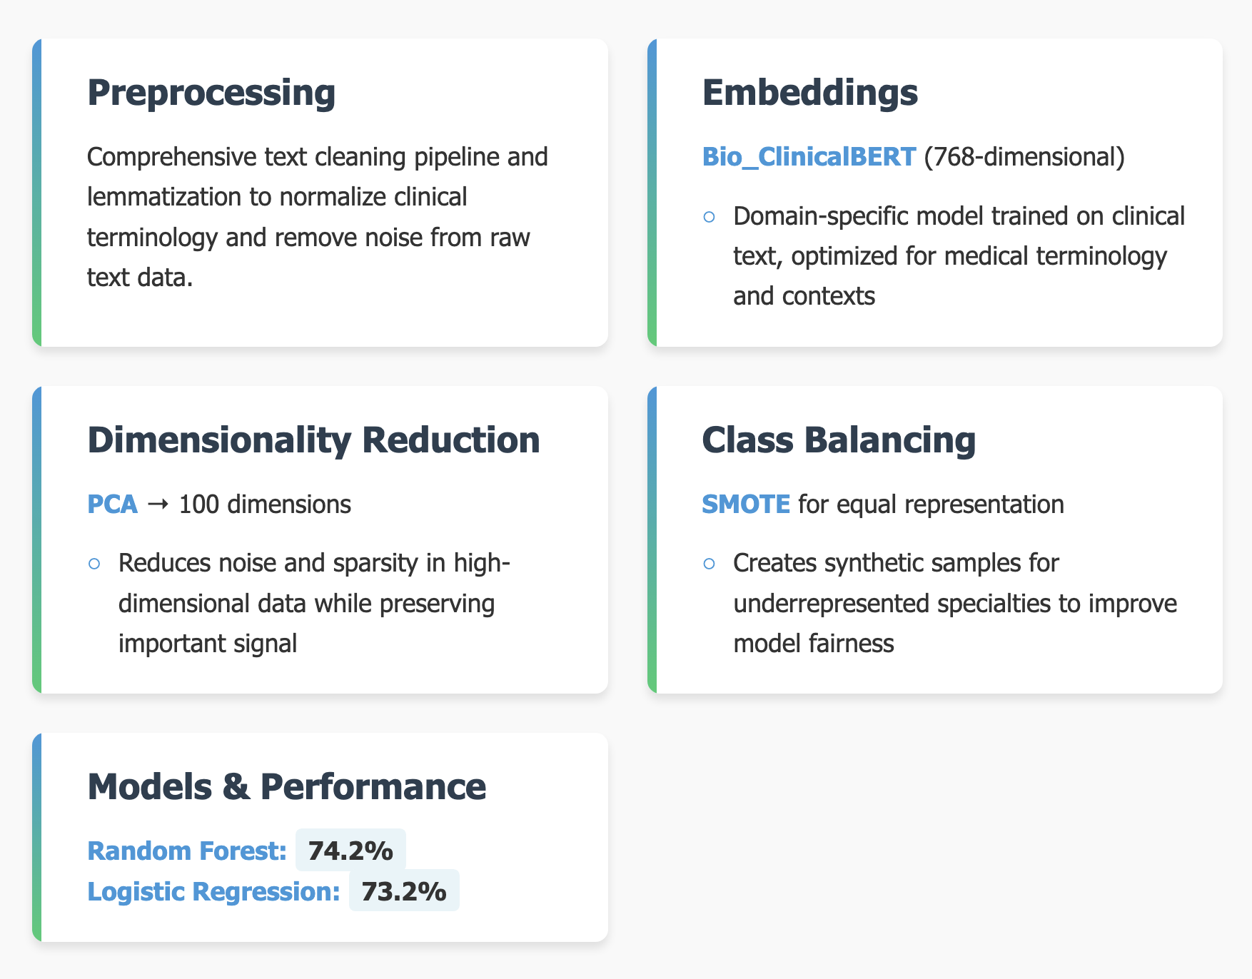
Methodology & Results : Random Forest & Logistic Regression
Notes:
This project uses Bio_ClinicalBERT to classify medical documents by specialty. Starting with the MTSamples dataset, we filtered down to 2,324 documents across 12 medical specialties.
After preprocessing the text through cleaning and lemmatization, we generated embeddings using Bio_ClinicalBERT, which is specifically trained on clinical text. This gives us 768-dimensional vectors that capture medical terminology and context far better than general language models.
To improve model performance, we applied dimensionality reduction with PCA, bringing the embeddings down to 100 dimensions while reducing noise and sparsity in the high-dimensional data.
Since our dataset was imbalanced with some specialties having many more documents than others, we implemented SMOTE to create synthetic samples for underrepresented specialties, ensuring our model wouldn't be biased toward common specialties.
Finally, we trained two models: Random Forest, which achieved 74.2% accuracy, and Logistic Regression at 73.2%. The Random Forest model became our final classifier for this task.
Bullet Point Flow for Practice
Start with data overview
MTSamples → 2,324 documents across 12 specialties
Filtered from original 40 specialties for better classification
Walk through the pipeline steps
Text preprocessing → cleaned and lemmatized text
Bio_ClinicalBERT → domain-specific embeddings (768 dimensions)
PCA → reduced dimensions while preserving information
SMOTE → balanced dataset for fair training
Finish with model performance
Random Forest outperformed Logistic Regression
74.2% overall accuracy despite challenging task
Highlight this is our final model
https://mermaid.live/edit#pako:eNqNkVtvozAQhf-K5b6mERBCGh5WCpdc2o22SvK0pFq5eCDWGhzZZts0yn9f46Bs-7IC8cD4fGeOZzjjXFDAIS64eMsPRGq0S_Y1Ms8sW--2pDpyUCghmijQL-j-_huKsrZEzxKORBLNRP1ydURWjrMdvGsrS5GDUqwuOyC2QJJFTPyKOatZTniUbnYorV6BUgOqjkwsmWYJq6BWJoJwpk9oA7TJ20T0xvQBPcezjk8tP8-26x-7FMWcKIUiwkmd_0ufW2aRrc3EHO0kMRe4iQsrLt1sQ2oqKjQXEpT-KnrZd1EypVluLlLKdrTb7EvXMquue_qH8ObzbpbeVb9WK1s8ZnNmBkNfIpFt0LkeLfeUrYG2u0LbI-SMcLMJOyIrzGkXcjUofeKAZqhgnId31IdxUQyUluI3hHfT_DWg8BmM-oJxXzDpC6Z9wXlfcNEXNP-qL-n1JVd9wce-4NP_QDzApWQUhwXhCga4AlmRtsbntsce6wNUsMeh-aRQkIbrPd7XF-M7kvqnEBUOtWyMU4qmPNz6NEdKNCSMlJJUt1MJNQUZi6bWOBy5tgcOz_jdVI4znE5GE8cPAs_x3WCATzh0A2_oBUHg-tMH332YON5lgD9sqjMMPHcy9ifOeGpe1x9d_gK1i2qb

Slide 12

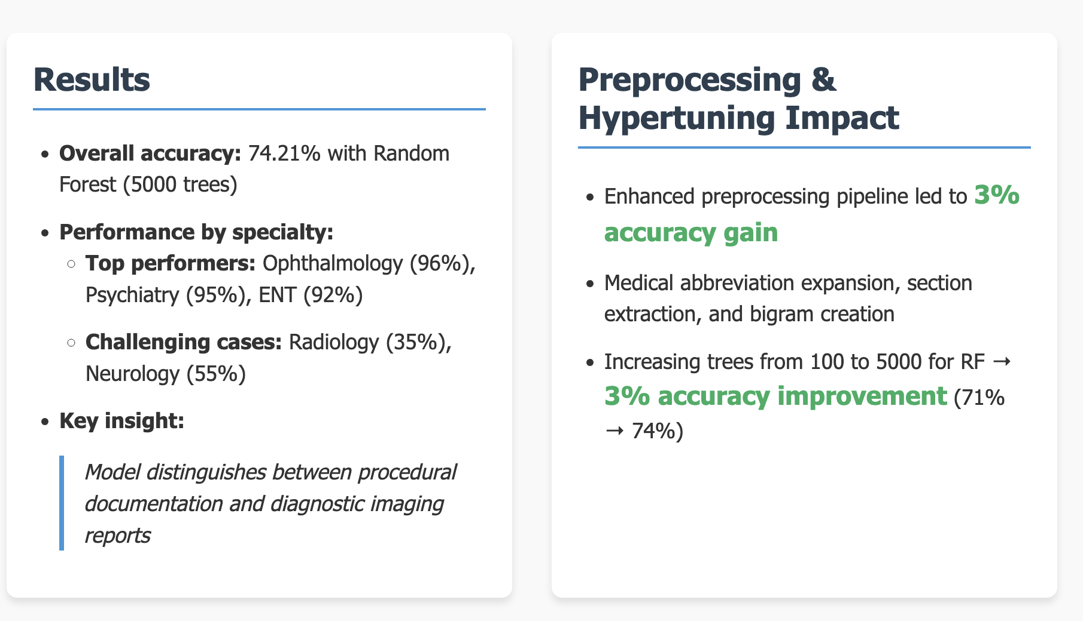
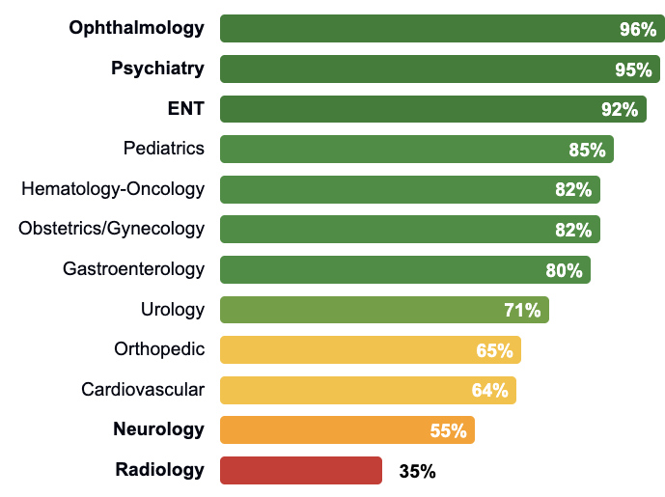
RF and LR : Results & Insights
F1 Score by Specialty (%)
Notes:
"Moving to our results, our Random Forest classifier with 5000 trees achieved an overall accuracy of 74.21%.
Performance varied dramatically across specialties. Our top performers were Ophthalmology at 96%, Psychiatry at 95%, and ENT at 92% - all specialties with highly structured documentation patterns. In contrast, Radiology at only 35% and Neurology at 55% proved challenging.
Our key insight: the model performs significantly better on specialties that use procedural documentation compared to those relying on diagnostic imaging reports. This explains why specialties with standardized terminology consistently outperformed others.
We achieved these results through two improvement phases. First, our enhanced preprocessing pipeline delivered a 3% accuracy gain by focusing on diagnostically relevant sections rather than entire documents, which reduced noise and highlighted specialty-specific terminology.
Then, by increasing our Random Forest from 100 to 5000 trees, we gained an additional 3% improvement because the larger ensemble better captured the complex decision boundaries between medical specialties."
Headline Result
Random Forest with 5000 trees → 74.21% accuracy
Multi-class problem across 12 specialties
Performance Variation
Top: Ophthalmology (96%), Psychiatry (95%), ENT (92%)
Bottom: Radiology (35%), Neurology (55%)
Pattern: Specialties with structured documentation performed better
Key Insight
Procedural documentation → High performance
Diagnostic imaging reports → Lower performance
Standardized terminology is a strong predictor of model success
Improvement Phase 1: Preprocessing
Enhanced preprocessing → +3% accuracy (68% → 71%)
Focus on diagnostically relevant sections
Reduced noise, highlighted specialty-specific terminology
Improvement Phase 2: Hypertuning
Increasing trees from 100 to 5000 → +3% accuracy (71% → 74%)
Larger ensemble captured complex decision boundaries
Demonstrated that model complexity benefits this task

Slide 13

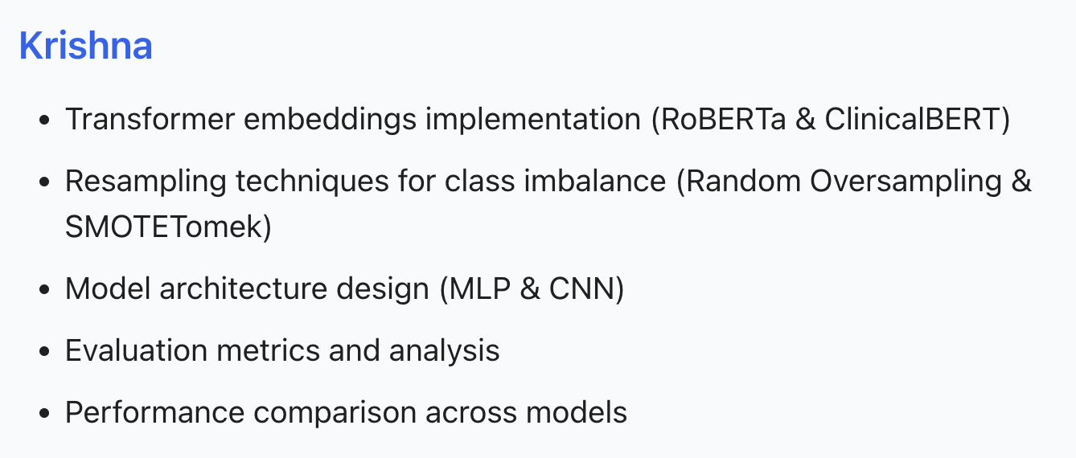
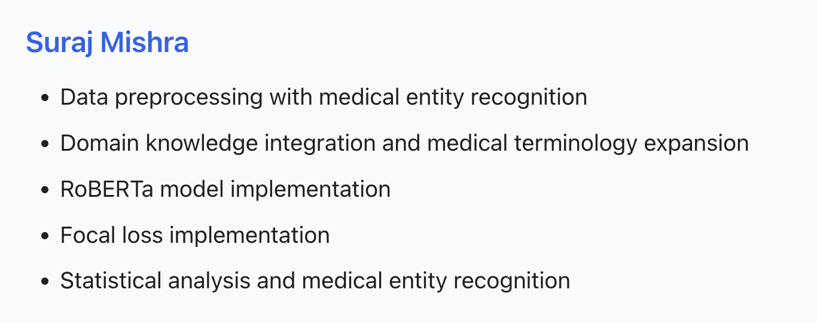

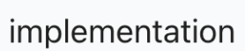
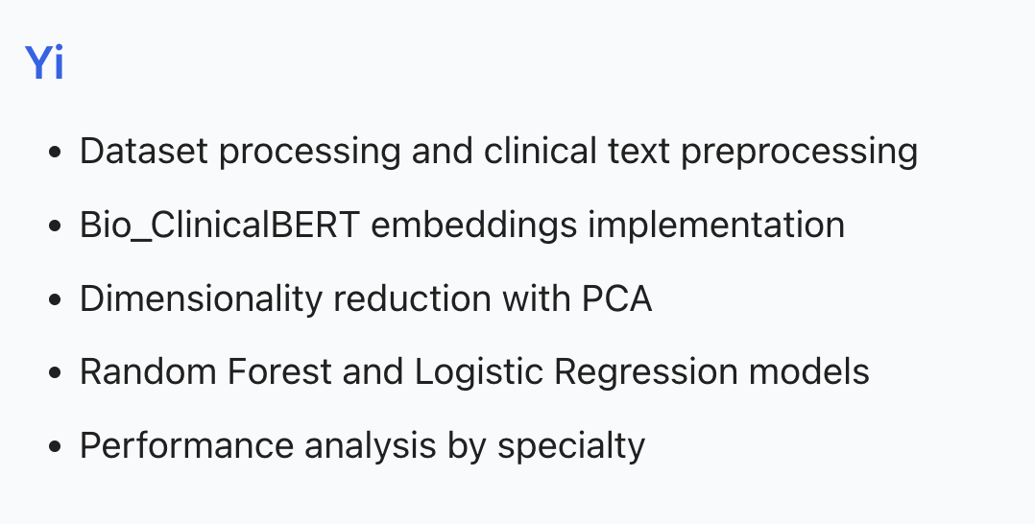
Notes:
https://mermaid.live/edit#pako:eNqNkVtvozAQhf-K5b6mERBCGh5WCpdc2o22SvK0pFq5eCDWGhzZZts0yn9f46Bs-7IC8cD4fGeOZzjjXFDAIS64eMsPRGq0S_Y1Ms8sW--2pDpyUCghmijQL-j-_huKsrZEzxKORBLNRP1ydURWjrMdvGsrS5GDUqwuOyC2QJJFTPyKOatZTniUbnYorV6BUgOqjkwsmWYJq6BWJoJwpk9oA7TJ20T0xvQBPcezjk8tP8-26x-7FMWcKIUiwkmd_0ufW2aRrc3EHO0kMRe4iQsrLt1sQ2oqKjQXEpT-KnrZd1EypVluLlLKdrTb7EvXMquue_qH8ObzbpbeVb9WK1s8ZnNmBkNfIpFt0LkeLfeUrYG2u0LbI-SMcLMJOyIrzGkXcjUofeKAZqhgnId31IdxUQyUluI3hHfT_DWg8BmM-oJxXzDpC6Z9wXlfcNEXNP-qL-n1JVd9wce-4NP_QDzApWQUhwXhCga4AlmRtsbntsce6wNUsMeh-aRQkIbrPd7XF-M7kvqnEBUOtWyMU4qmPNz6NEdKNCSMlJJUt1MJNQUZi6bWOBy5tgcOz_jdVI4znE5GE8cPAs_x3WCATzh0A2_oBUHg-tMH332YON5lgD9sqjMMPHcy9ifOeGpe1x9d_gK1i2qb
This project uses Bio_ClinicalBERT to classify medical documents by specialty. Starting with the MTSamples dataset, we filtered down to 2,324 documents across 12 medical specialties.
After preprocessing the text through cleaning and lemmatization, we generated embeddings using Bio_ClinicalBERT, which is specifically trained on clinical text. This gives us 768-dimensional vectors that capture medical terminology and context far better than general language models.
To improve model performance, we applied dimensionality reduction with PCA, bringing the embeddings down to 100 dimensions while reducing noise and sparsity in the high-dimensional data.
Since our dataset was imbalanced with some specialties having many more documents than others, we implemented SMOTE to create synthetic samples for underrepresented specialties, ensuring our model wouldn't be biased toward common specialties.
Finally, we trained two models: Random Forest, which achieved 74.2% accuracy, and Logistic Regression at 73.2%. The Random Forest model became our final classifier for this task.
Bullet Point Flow for Practice
Start with data overview
MTSamples → 2,324 documents across 12 specialties
Filtered from original 40 specialties for better classification
Walk through the pipeline steps
Text preprocessing → cleaned and lemmatized text
Bio_ClinicalBERT → domain-specific embeddings (768 dimensions)
PCA → reduced dimensions while preserving information
SMOTE → balanced dataset for fair training
Finish with model performance
Random Forest outperformed Logistic Regression
74.2% overall accuracy despite challenging task
Highlight this is our final model

Slide 14
